Slide 1
Credit project
User guide
Quant research group
Paris, October 2020

Slide 2
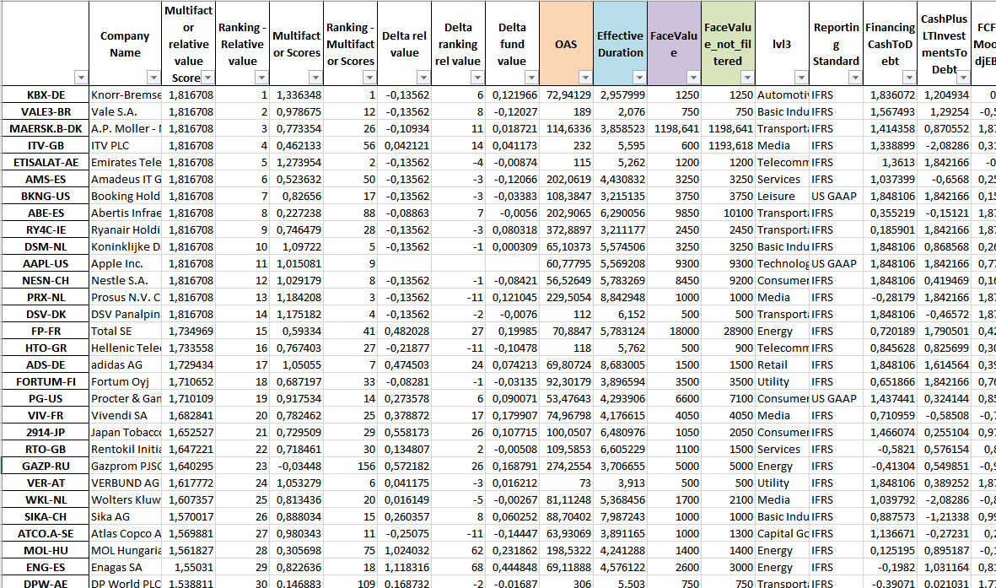
Methodology
We have a model that uses credit factors in order to explain the cross-section of corporate bond expected returns for the U.S. and Euro Investment Grade and U.S. High Yield universes.
Using Bank of America Merrill Lynch (BoAML) database we select the issues that belong to the benchmark in this month and for them we take information like option-adjusted spread (OAS), the effective duration or the face value.

Slide 3
Methodology
We filter (≥400M, senior, not distressed) to select a investible universe and we aggregate the information we have at an issuer level taking the average of the bonds weighted by the market value, with the except of the face value, which is simply the sum over the issues of an issuer.
With respect of the face-value, we consider both the face-value over in the investible universe and the “not filtered” one, in order to understand the size of that issuer in that market.

Slide 4
Methodology
Using Worldscope database we go and compute the 11 indicators that form this model:
Financing Cash over Debt
Cash and long term Investments over Debt
Free Cash flows over Moody’s adjusted EBITDA
EBITA over Interest Expense
Free Cash flows over Debt
Debt over market capitalization
Distance to default
52 weeks high momentum
Net profit after Tax before unusual Expense over Averaged Assets
Book to Price
Cash Flows to market capitalization

Slide 5
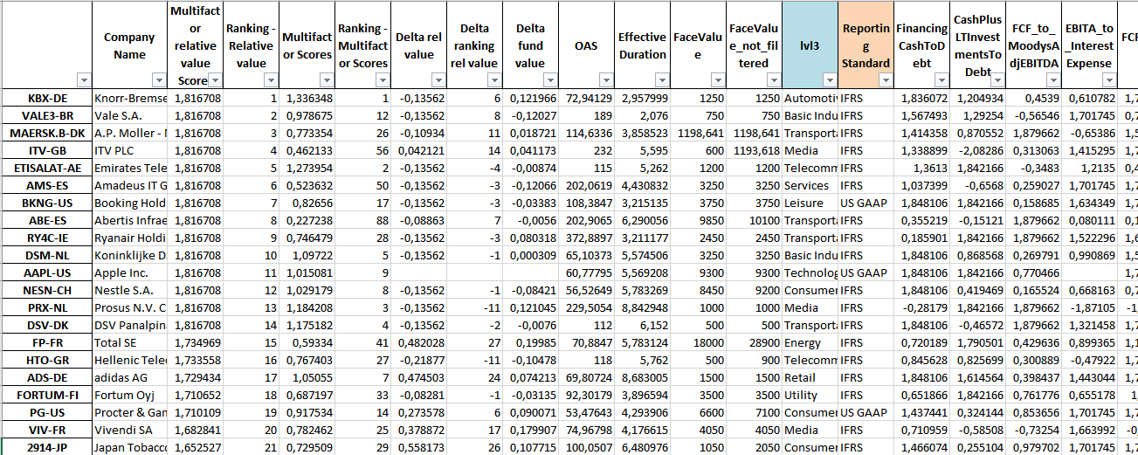
Methodology
Over each of these 11 indicators we compute a fundamental score. This is done through a neutralization of the belonging to a sector and a reporting standard and a FZ-score in order to make all the different ratios having the same magnitude and removing the outliers.
These two operations let us score “good” and “bad” issuers for each BoAML sector and reporting standard, positive or negative scores. However, computing a FZ score over the whole universe we may have that not each sectorial mean is exactly zero.

Slide 6
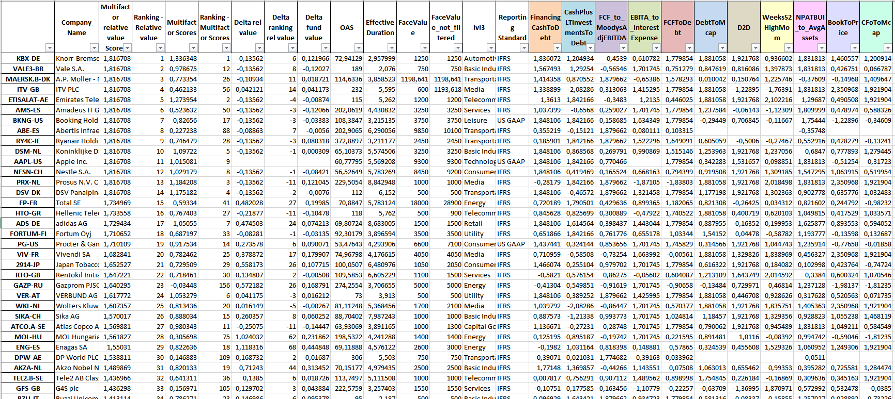
Methodology
We have the neutralized scores of each indicator not yet taken with its sign or the opposite, whether it is follower or antagonist, i.e. a value trap.

Slide 7
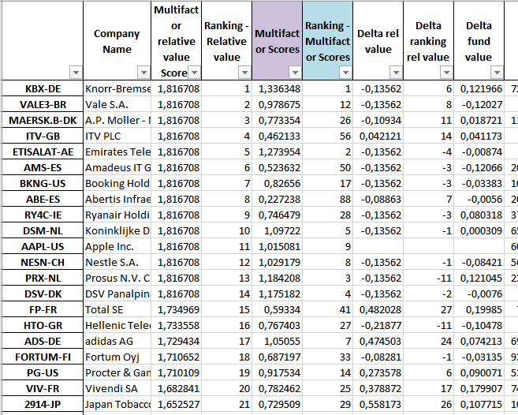
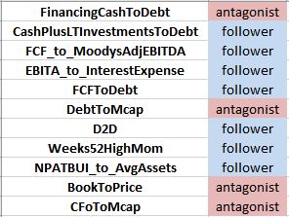
Methodology
Considering the nature of the each ratio, whether it is follower or antagonist we take respectively the score or its opposite and we compute the weighted over ratios of the same style a mean.
We obtain this way a multi-factor score and we compute the ranking of each company with respect to the whole universe over this criterion.

Slide 8
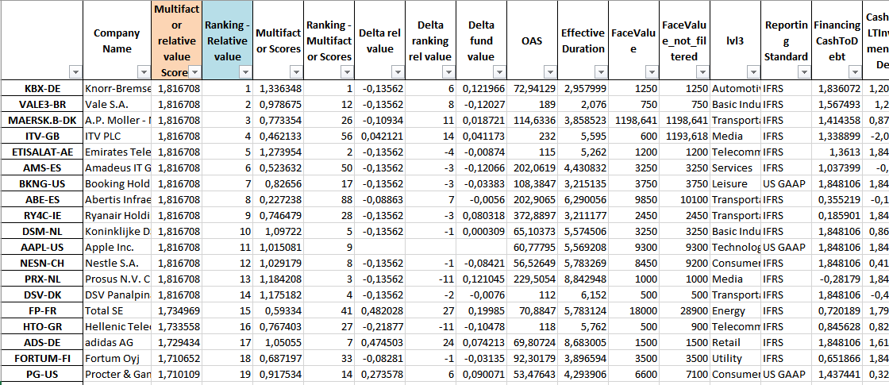
Methodology
We neutralize now over OAS, duration and face-value (not filtered) in order to obtain the Relative value score. Doing so we have that we have “good” and “bad” companies for every level of spread.
We compute even in this case the ranking variable and we sort the whole dataframe through this criterion.

Slide 9
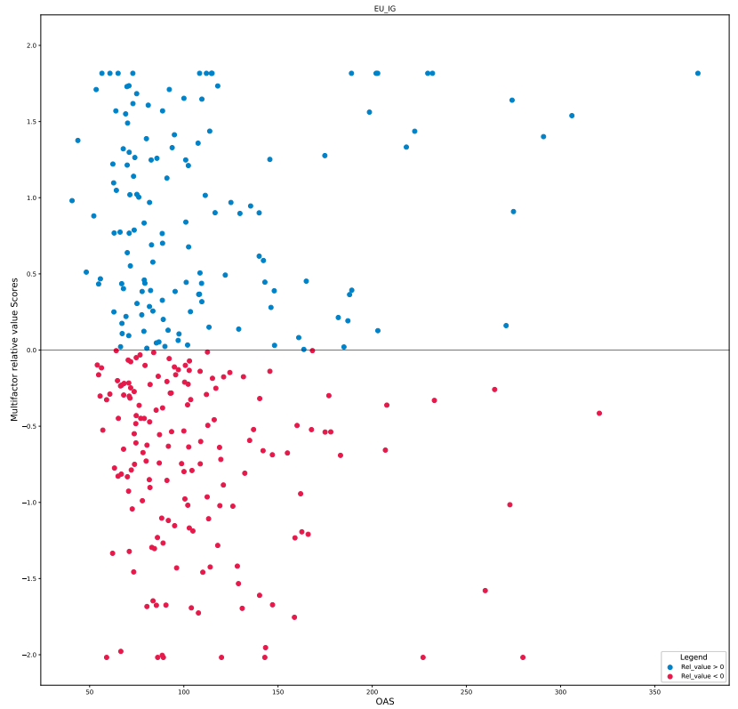
Methodology
Considering this score we analyze the three different universes (U.S. and Euro Investment Grade and U.S. High Yield).

Slide 10
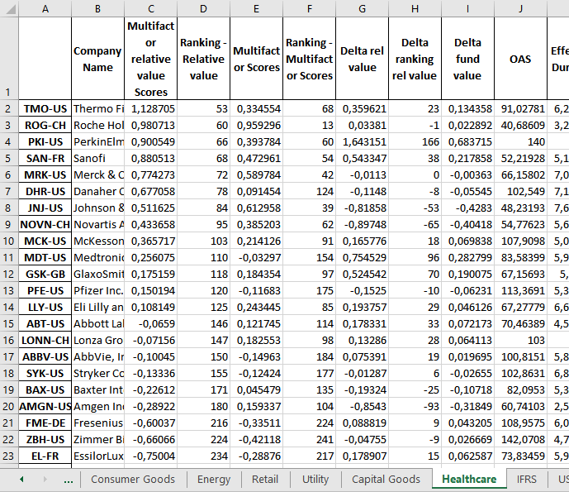
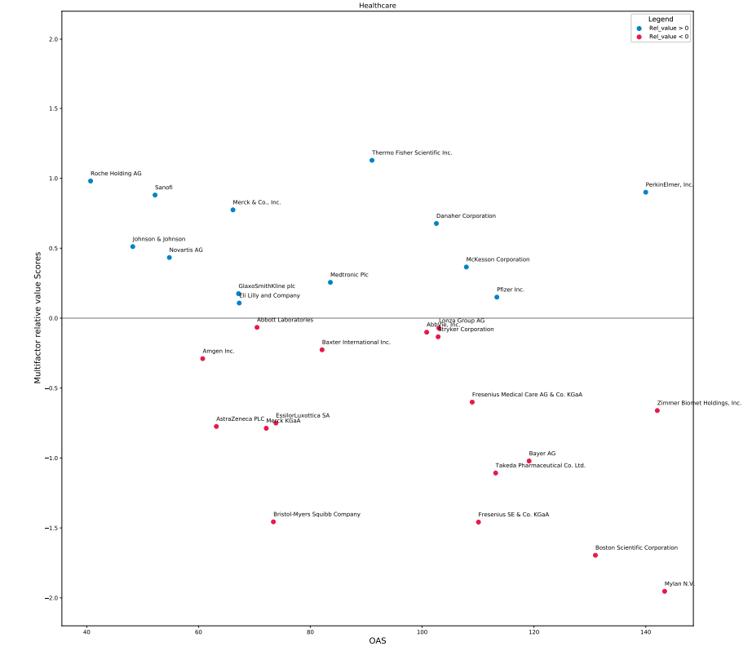
Methodology
At each release of the screening a focus is also done for each sector (e.g. Healthcare) to better see the scores of each company.

Slide 11
Annexes

